Slide 1
POWER POINT PRESENTATION
CONTENTS A
컨텐츠에 대한 내용을 적어요
Enjoy your stylish business and campus life with BIZCAM
냉장고를 부탁해~!!
CONTENTS A
컨텐츠에 대한 내용을 적어요
Enjoy your stylish business and campus life with BIZCAM
CONTENTS A
컨텐츠에 대한 내용을 적어요
Enjoy your stylish business and campus life with BIZCAM
CONTENTS A
컨텐츠에 대한 내용을 적어요
Enjoy your stylish business and campus life with BIZCAM
CONTENTS A
컨텐츠에 대한 내용을 적어요
Enjoy your stylish business and campus life with BIZCAM

Slide 2
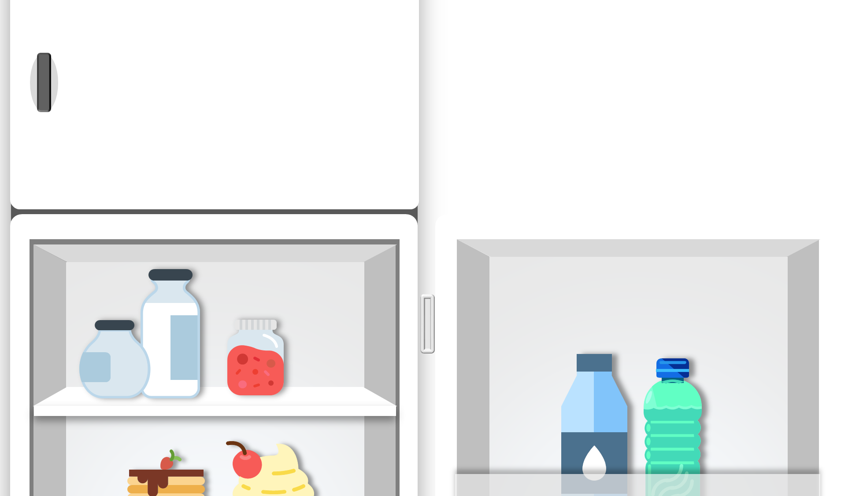
홍길동
OO 대학교 OO학과 00학번
E-mail : sdfws@naver.com
Blog.naver.com/sdf
POWER POINT PRESENTATION
PowerPoint is a computer program
created by Microsoft Office
Enjoy your stylish business and
campus life with BIZCAM

